Slide 1
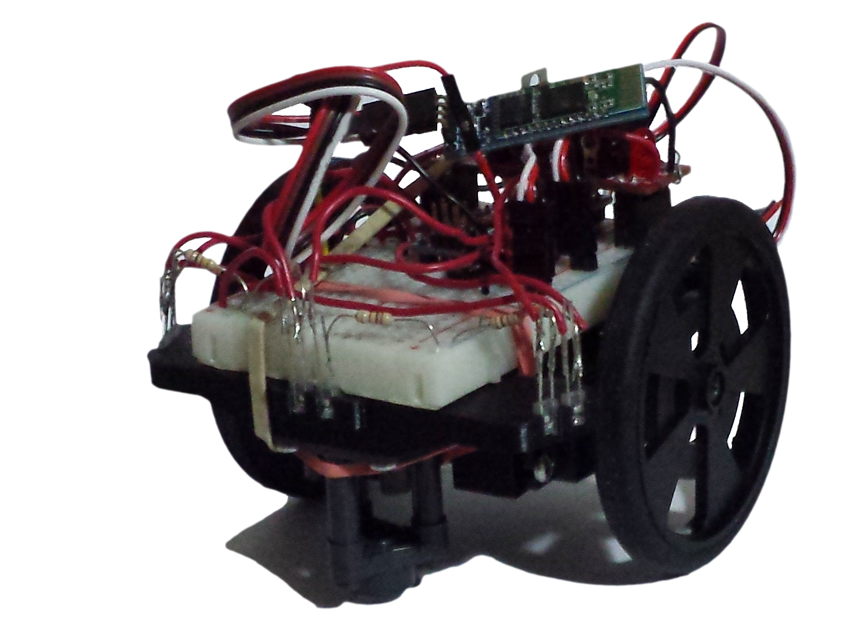
Nanomouse
Group Members: Jason Nixon, Mohammad Sameeh, Guillermo Fabian

Slide 2
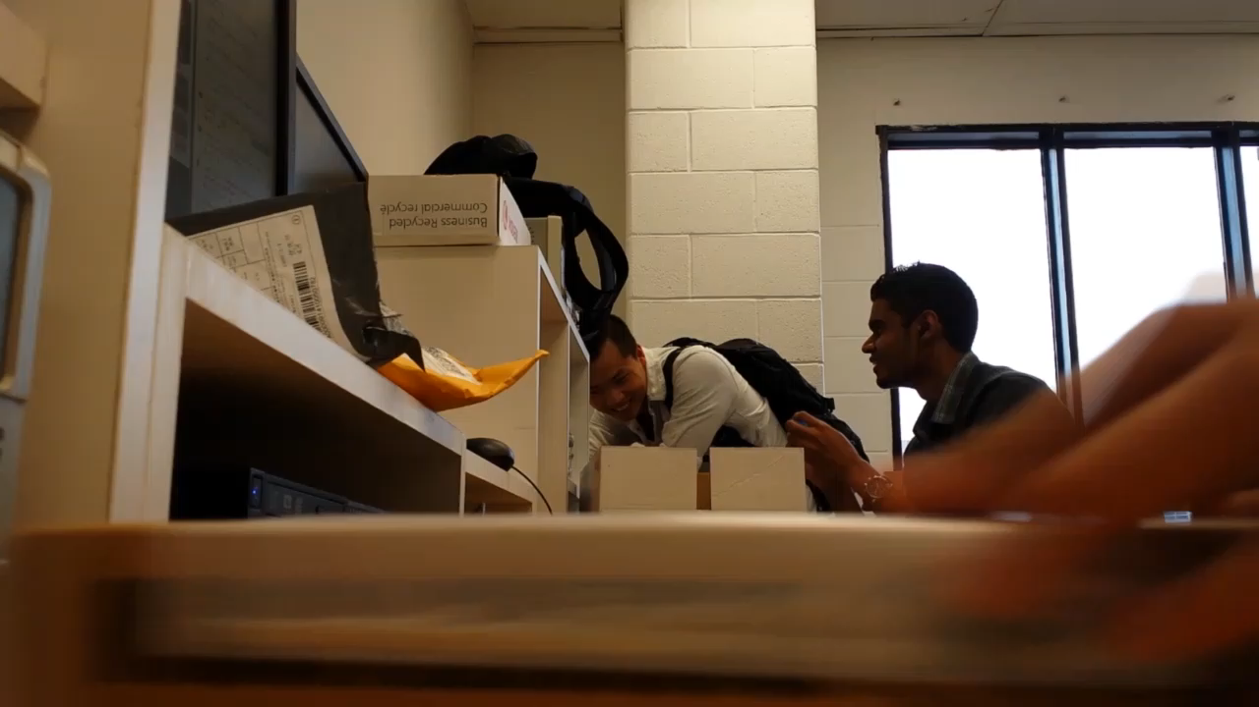
Introduction - Hardware Production

Slide 3
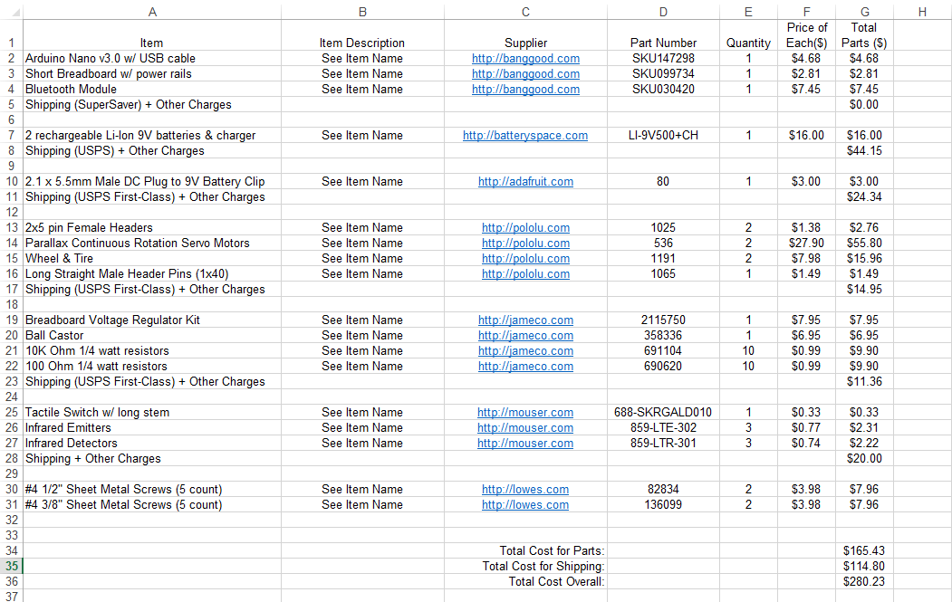
Project Bill of Materials

Slide 4
Algorithm – Schedule
January
Began researching Flood Fill Algorithm
February-March
Implementation of the Algorithm
April
Testing/Debugging code

Slide 5
Algorithm – Previous Courses
CENG 512 – Hardware Production
Soldering, scheduling projects.
CENG 510 – Algorithm & Data Structure in Java
Understanding algorithms. Its effectiveness.
CENG 302 – System Analysis
Documentation & Github.
TECH 101 – Electrical Circuits
Understanding & debugging circuits.
TECH 104 – Programming Fundamentals
Learning the basics of programming

Slide 6
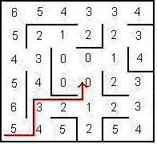
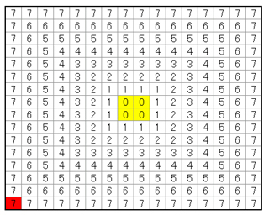
Algorithm – Flood Fill

Slide 7
Database – Placeholder 1

Slide 8
Database – Placeholder 2

Slide 9
Database – Placeholder 3

Slide 10
Application – Placeholder 1

Slide 11
Application – Placeholder 2

Slide 12
Application – Placeholder 3

Slide 13
Conclusion

